Slide 1

TRAVEL BEES
Using springboot

Slide 2
Contents
System Description
Requirements
Functional Modules
Use Case Diagram
Class Diagram
List of Operations

Slide 3
System Description
The TravelBee Spring Boot Project aims to enhance the tourism experience by providing tourists with a convenient and reliable platform for exploring and navigating through various destinations.
The system aims to provide an efficient platform for managing travels Navigators, bookings, tourist information, and other essential tasks required for effective management.
It leverages modern technologies and best practices to deliver a feature-rich and user-friendly application.

Slide 4




Requirements
Application will be developed using following Sprints:
IDE :
Spring Tool Suite(STS)
Back-End Tools Front-End Tools
Spring Boot 3 Visual Studio Code
Hibernate + JPA
PostgreSql
Postman

Slide 5
Functional Modules
User
Navigator
Booking
Security

Slide 6
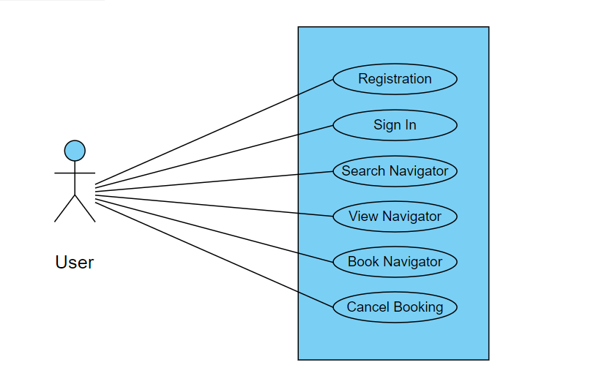
Use Case Diagram

Slide 7
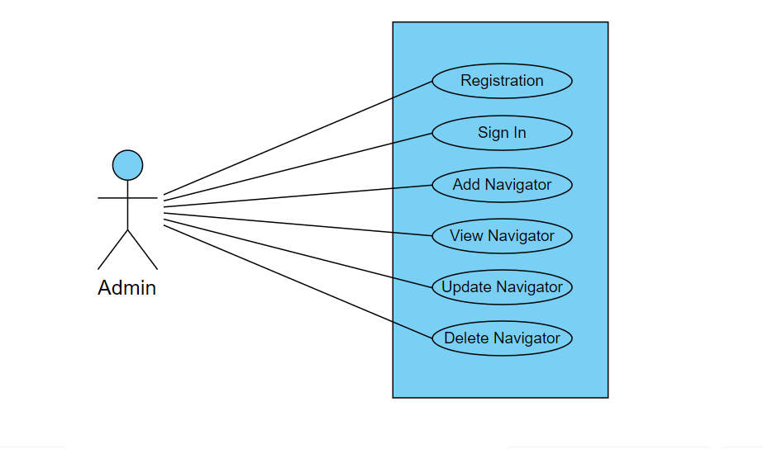

Slide 8
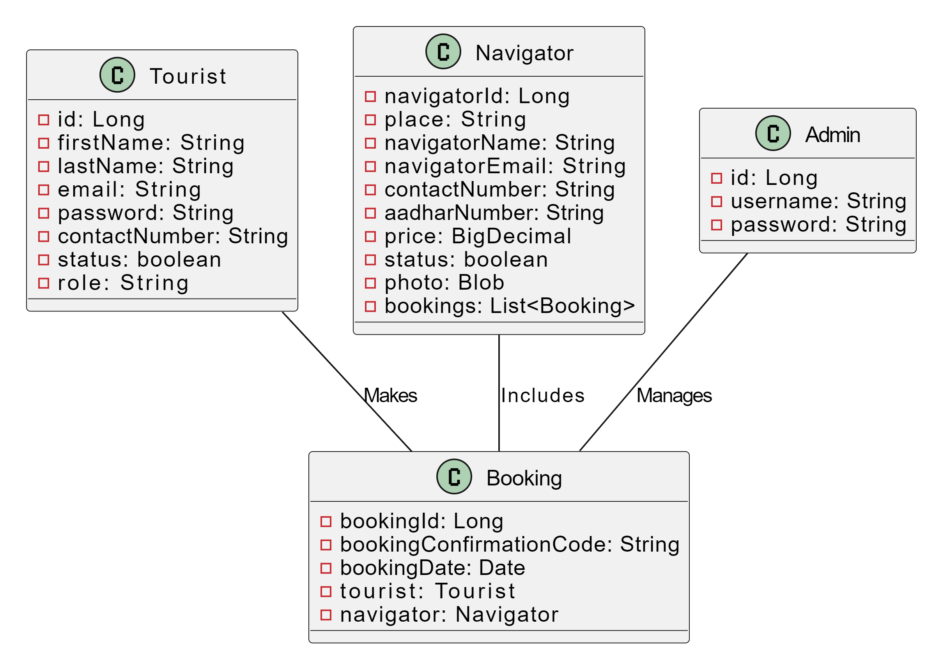
Class Diagram

Slide 9
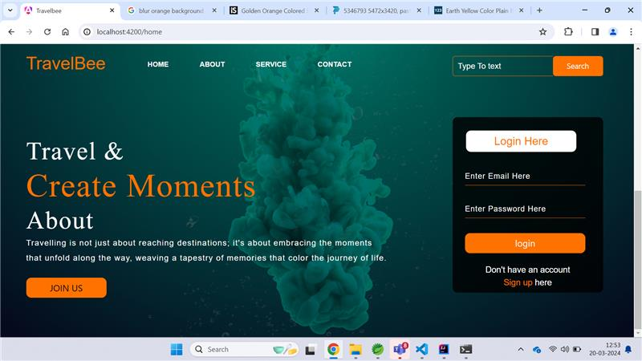

Slide 10
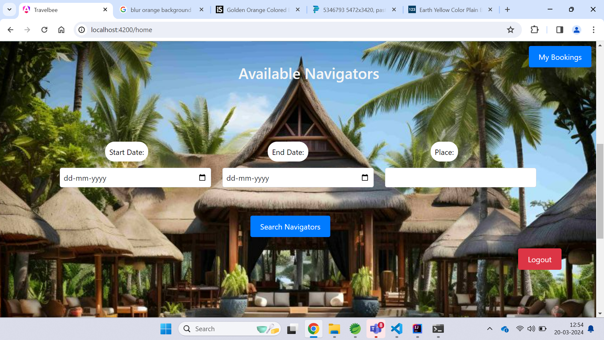

Slide 11
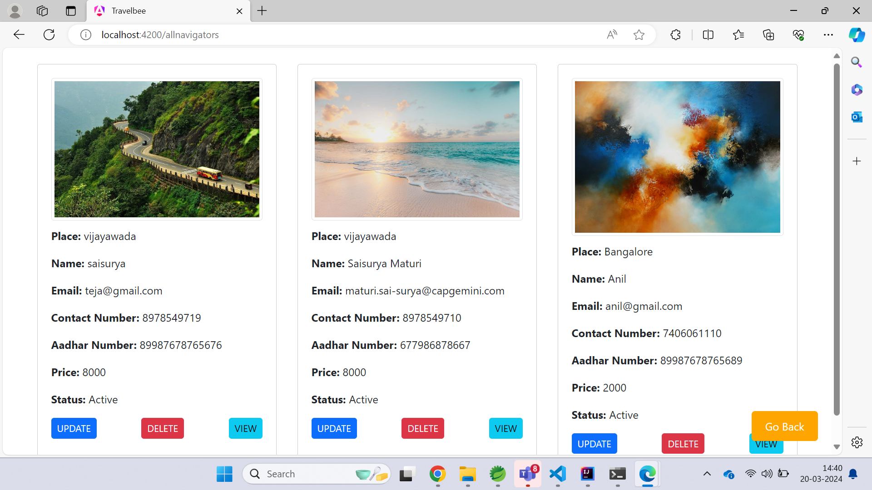

Slide 12
List of Operations
Navigator Controller
addNavigator
getAllPlaces
getAllNavigators
getNavigatorByNavigatorId
getAvailableNavigators
updateNavigator
deleteNavigator
Booking Controller
addNavigator
viewAllBookings
getBookingByTouristEmail
getBookingByConfirmationCode
cancelBooking
User
signUp
login
updateTourist
forgotPassword

Slide 13

THANK YOU

